Slide 1
PRS legal update
Energy efficiency
Housing Bill
Awaab’s Law

Slide 2

Meeting MEES
The latest proposals for a minimum energy efficiency standard

Slide 3

There are currently NO MINIMUM STANDARDS in private rented sector
2023 consultation proposals
Minimum energy efficiency standard “MEES” by 2028
Clean heating system by 2045

Slide 4
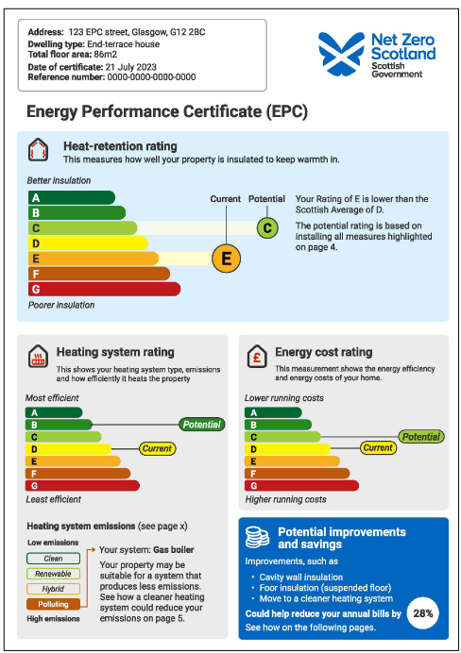
EPC reform
Validity reduced from
10 years to 5 years

Slide 5
2025 consultation proposals
Heat Retention Rating (HRR) of C or above
From 1/4/2028 at change of tenancy
By 31/12/2033 for all remaining PRS properties

Slide 6
HRR of C or above
“Our early analysis indicates that around 80% of homes currently achieving EPC band C are likely to achieve band C in the new EPC HRR”
Buildings using an inexpensive heating fuel but with leaky building fabric will see that reflected in a poorer rating under the HRR
Similarly, buildings using an expensive fuel, such as electricity, but with good insulation will perform better in the HRR
The heating system is not relevant to the HRR.

Slide 7
Ways to improve HRR
Loft/roof insulation
Cavity/solid wall insulation
Floor insulation
Double/secondary glazing
Insulate external doors
Draught proofing of windows, doors and loft hatch
Baffles or dampers to block open chimneys when not in use

Slide 8
New “HEETSA” assessment
The Scottish Government is consulting on introducing a Heat and Energy Efficiency Technical Suitability Assessment (HEETSA).
A bespoke technical assessment which would be a step beyond the EPC assessment and could be used to identify which energy efficiency improvement measures would be technically suitable for a particular building (and which would not).
It would be OPTIONAL
Assessors would be accredited by a government-authorised bodies
Unlikely to be available until 2028

Slide 9
PRS MEES exemptions
Consent (5 years)
Negative impact on fabric or structure of the domestic PR property (5 years) – as determined by independent architect, independent chartered engineer, independent charted building surveyor, or independent chartered architectural technologist
Where landlord purchases/inherits property with sitting tenant (6 months)
No relevant energy efficiency improvements
All relevant energy efficiency improvements have been undertaken
Cost cap (until change in ownership) - £10,000

Slide 10
Cost cap example
Improvement works required to reach HHR C:
Loft insulation - £2000
Double glazing - £6000
Wall insulation - £9000
Option 1: do wall insulation – total expenditure £9000 – then register exemption
Option 2: do loft insulation and double glazing – total expenditure £8000 – then register exemption

Slide 11
Funding
Only work which you can obtain government funding (a loan/grant) for has to be carried out.
Current funding is primarily through “PRS Landlord Loan Scheme”
<6 properties: can borrow up to £100,000
Interest free
6+ properties can borrow up to £250,000
3.5% APR
Must be repaid within 8 years

Slide 12
Steps to follow
Obtain new style EPC
If HRR is below C then from 1/4/28 can’t relet until work is done or exemption registered. All PRS properties must have HRR of C or above by 31/12/33. Explore improvement options recommended in EPC
If further guidance is needed on improvement options then discuss with retrofit co-ordinator or consider obtaining HEETSA assessment
Find contractors, obtain quotes and install measures
If property is still below C, do any exemptions apply? If so, register amendment with local authority. Property can then be marketed for rental with below C rating

Slide 13
Housing (Scotland) Bill 2024
Introduced under SNP/Green coalition – March 2024
Stage 2 – nearly 600 amendments proposed
Stage 3 – nearly 400 amendments proposed
Royal Assent (becomes legislation) likely over winter
Most measures require secondary legislation to firm up the details – so will come into force on different dates 2026-2027

Slide 14
Rent control
Local authorities do 5 yearly assessments of rent conditions using data gathered from landlords – first required by end May 2027
Based on these assessments Scottish Government decides whether or not to designate a “rent control area” (RCA)
RCA designation can last for up to 5 years
Within RCA – annual rent increases (between and mid-tenancy) capped at CPI + 1% up to maximum of 6% - with some exemptions – e.g. properties which have been improved
Outwith RCA – rent can increase annually to market value but not in first 12 months of tenancy

Slide 15
 | Within RCA | Outside RCA
Mid-tenancy amount | CPI + 1% (max 6%) | Market value
Mid-tenancy frequency | 12 monthly | 12 monthly (not in first 12 months of tenancy)
Between tenancy amount | CPI + 1% (max 6%) (but only if no increase in previous tenancy in last 12 months) | Market value
Long term empty | Market value (unless a previous tenancy ended less than 12 months ago) | Market value
Properties purchased with vacant possession | Market value | Market value

Slide 16


Pets/personalisation
Tenants can ask for permission to personalise property/keep a pet
Personalisation: category 1 changes don’t need permission, category 2 changes do
Landlord can’t unreasonably refuse permission
Will be guidance on what are reasonable grounds for refusal and what conditions can be imposed if giving permission
Still a lot of detail to iron out in secondary legislation

Slide 17
Ending joint tenancies
Current position:
PRT can only be ended by all tenants giving notice. Can lead to a tenant being “trapped” in a tenancy they no longer want to be part of
Housing Bill provision:
One tenant can end PRT for all on giving joint tenants 2-3 months notice then further 28 days notice to landlord

Slide 18
Penalties for wrongful termination
Current position:
Fine of 0-6 months rent
Housing Bill provision:
Fine of 3-36 times rent or £840 (whichever is higher)

Slide 19
Converting AT/SATs to PRTs
Legislation gives government the power to introduce further legislation to convert assured/short assured tenancies into PRTs
Would it actually be a bad thing? PRTs rules are easier, better eviction grounds and SAT “no fault” ground is no longer particularly beneficial now that all evictions are discretionary

Slide 20
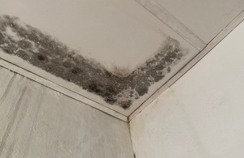
Awaab’s Law
Will be introduced in private and social rented sectors in Scotland from March 2026
Social housing providers in England will have to comply from 27 October 2025
Landlords will have to address damp and mould hazards that present a significant risk of harm to tenants to fixed timeframes

Slide 21
Timescales for social housing in England
Investigate and make safe emergency hazards within 24 hours. Emergency hazard = one that poses an “immediate and significant risk of harm” e.g. prevalent damp and/or mould that is having a material impact on a tenant’s health, for example their ability to breathe
Investigate and make safe significant hazards within 15 working days. Significant hazard = one that poses a significant risk of harm to health/safety of tenant
Start any further work required within 12 weeks

Slide 22
Hazards in scope of Awaab’s Law repair requirements
For a hazard to be in scope of the Awaab’s Law repair requirements, it must:
a) be a part of buildings or land for which the landlord is responsible
b) be in the landlord’s control to fix
c) not be damage that is a result of breach of contract by the tenant
d) result from defects, disrepair or lack of maintenance
e) be a significant or emergency hazard

Slide 23
Questions?
Tel: 0131 564 0100
Email: advice@scottishlandlords.com
www.scottishlandlords.com/resources

